Slide 1

Smart Medicine Bottle
Presented By
Syed Mohammad Moinul Islam Robin
Sumaiya Tasmim Nuha
Nusrat Jahan Kanta

Slide 2
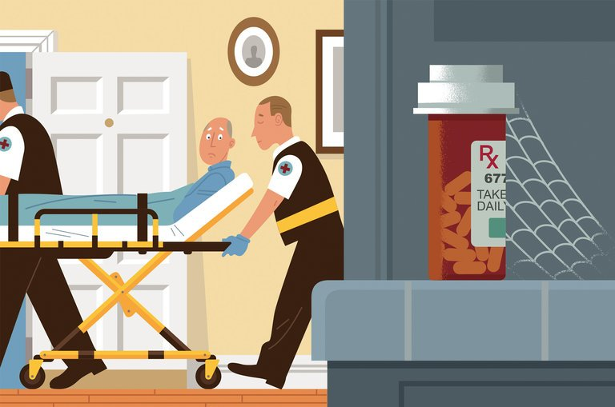
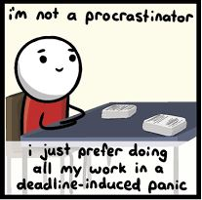
Problems
Procrastinate
Neglect
Distraction

Slide 3
Motivation

Slide 4
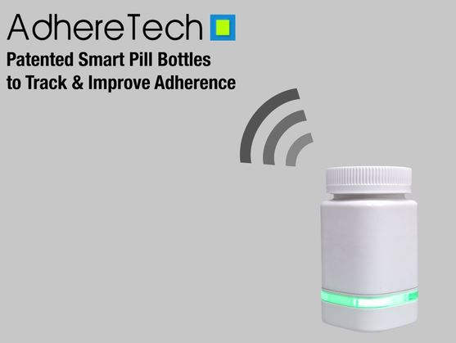
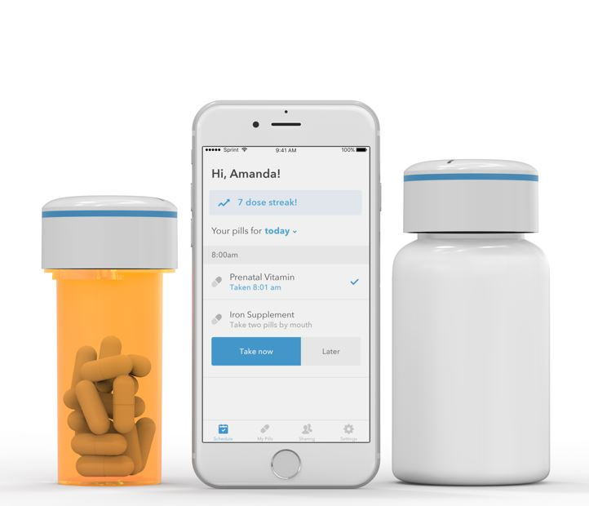
Existing Companies
Pillsy
Adhere Tech
Round Refill

Slide 5
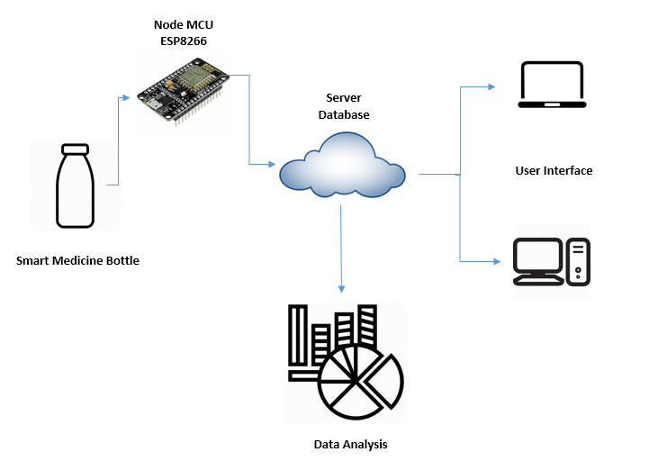
Solution
Remote Monitoring
Notification
Motivation

Slide 6
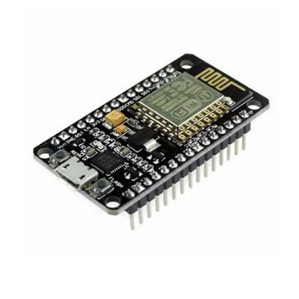
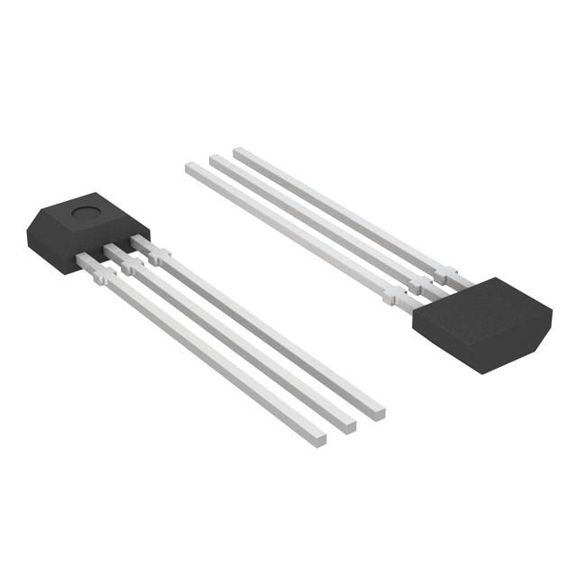
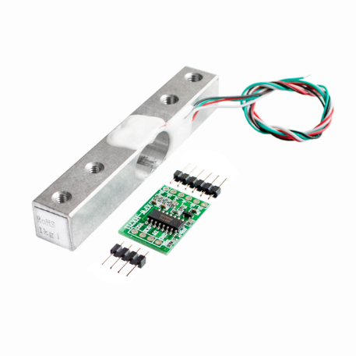
Hardware
Node MCU (ESP8266)
WiFi
Hall Effect Sensor
Load Cell
HX711 Amplifier
Neodymium Magnet

Slide 7


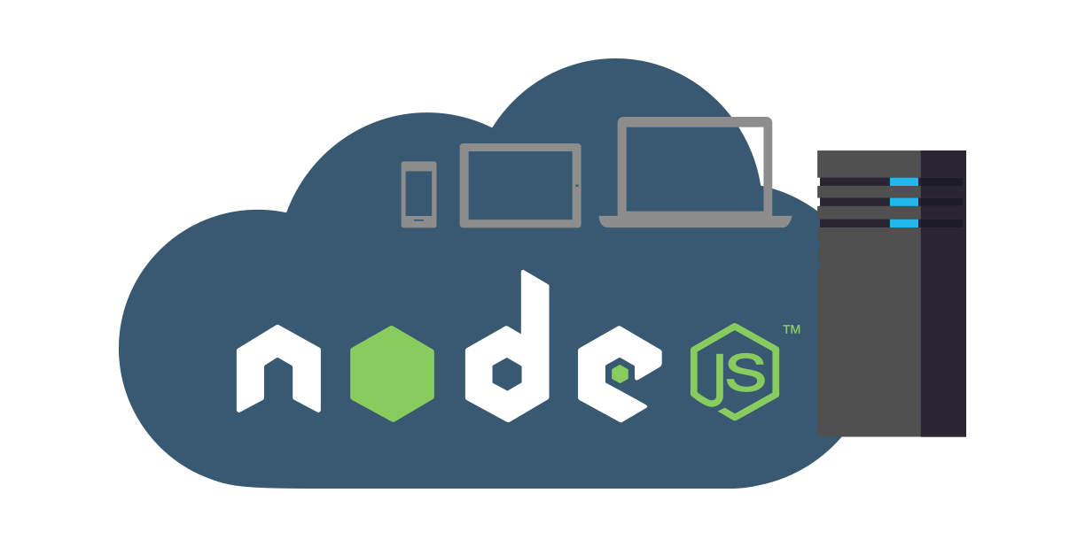


Development Platform

Slide 8
Technical Architecture

Slide 9
Challenges
Minimization of hardware
Right equipment
Notification
Server communication
Data analysis

Slide 10
Future Work
Minimization of hardware
Power optimization
Deep Sleep
Mobile application
Data collection
Data analysis
Behavioral pattern

Slide 11
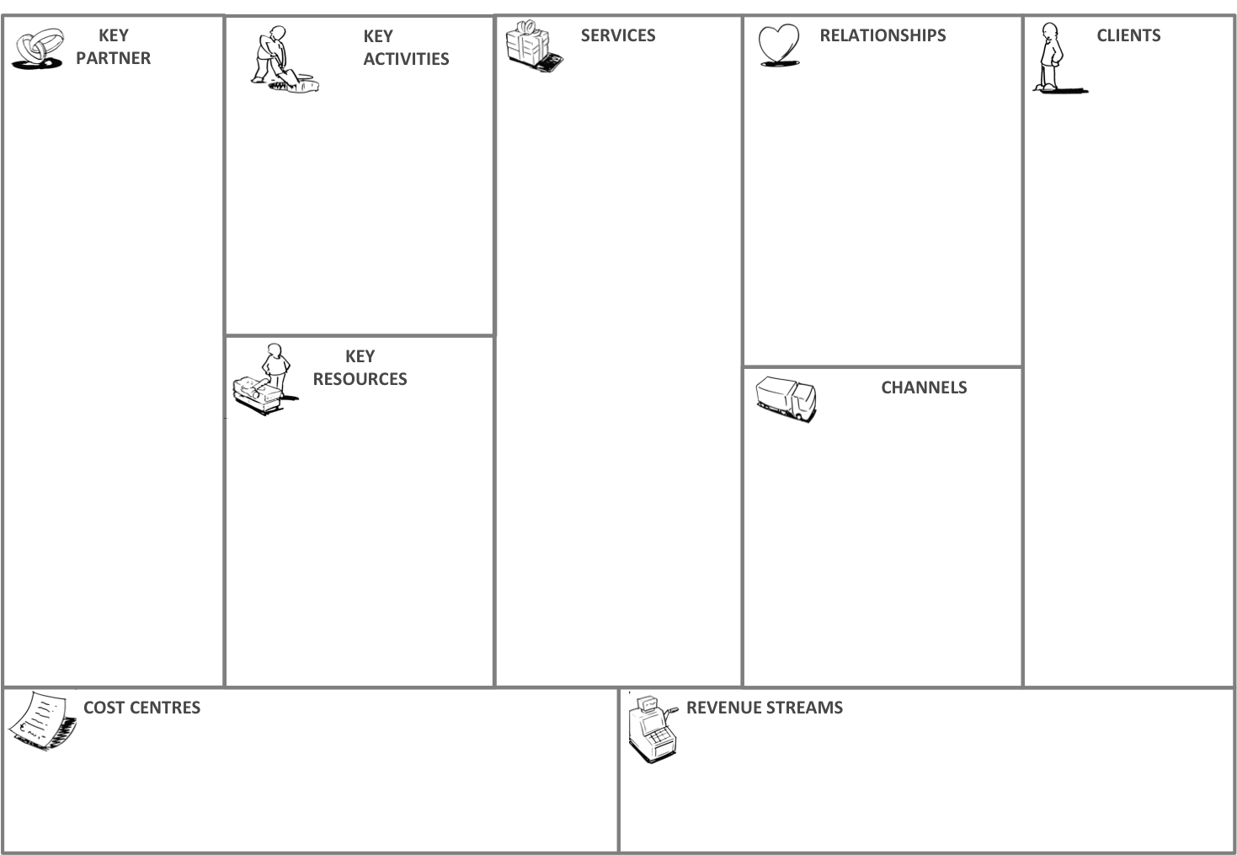
Business Model
KEY
PARTNER
KEY
ACTIVITIES
SERVICES
RELATIONSHIPS
CLIENTS
Hospitals
Personalized Automated Service
Elderly Citizens
Reminder
Elder citizens
Pharmaceuticals
Autistic residents
Risk Reduction
Overdose
Missing out doses
Automated, Personalized
Disable people
Disable people
KEY
RESOURCES
CHANNELS
Cloud Analysis
Behavioral Pattern
Research Purpose
Awareness
Companies & Hospitals
Autistic residents
Cloud Service
Financial Support
Intellectual & Human Resource
COST CENTRES
REVENUE STREAMS
Fixed cost platform
Cloud Costing
Buying cost of the system
Cloud Monitoring fee

Slide 12
Thank You

